Slide 1
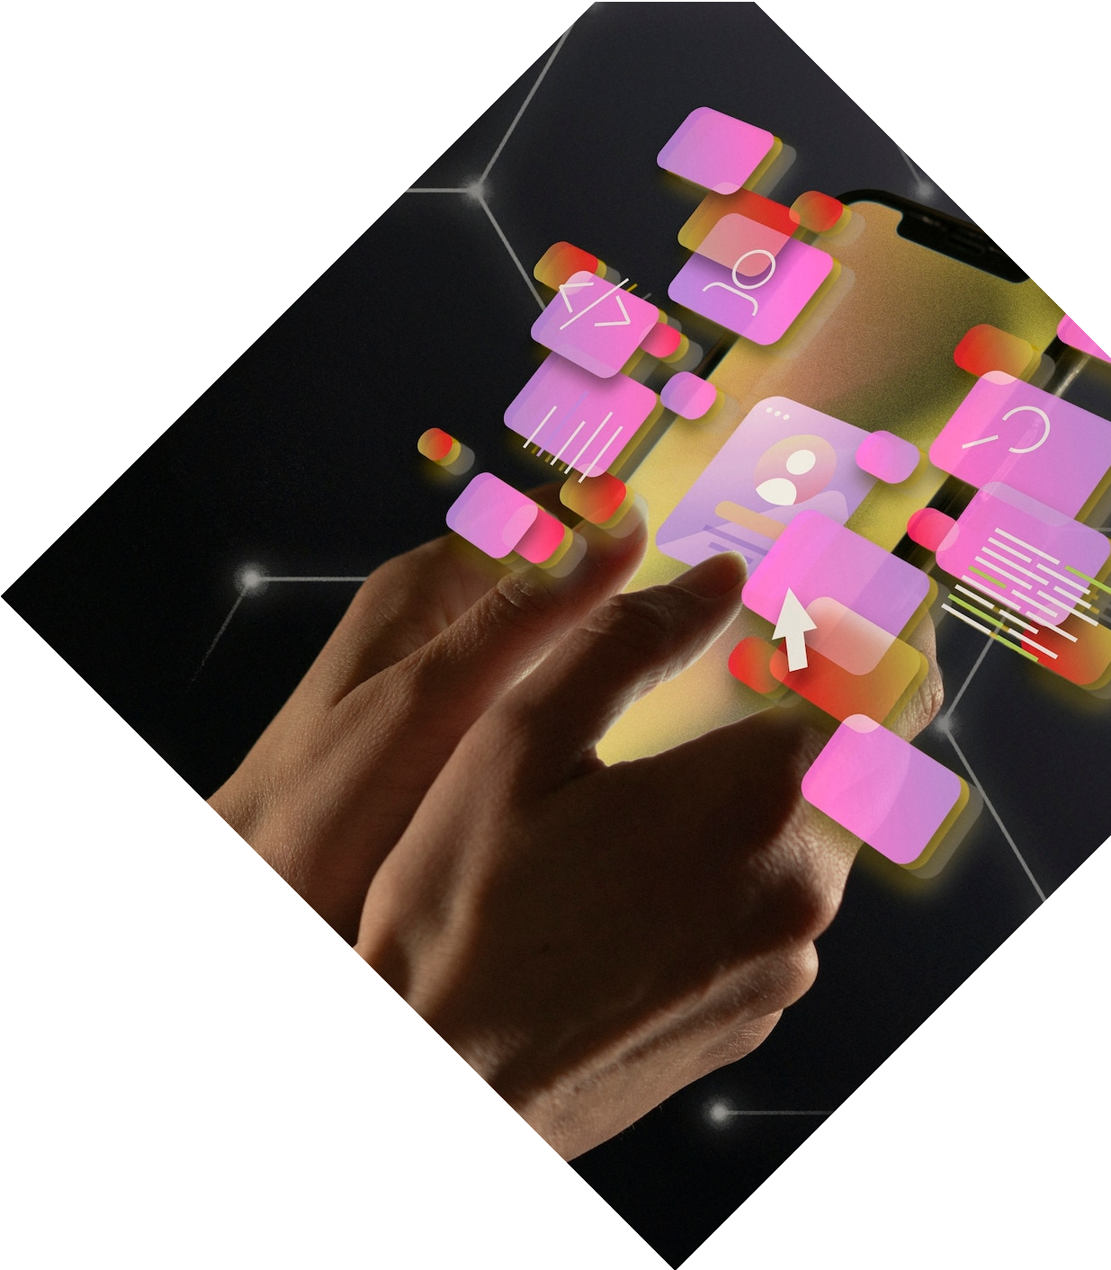

Seamless Scheduling: Revolutionizing Appointments with a SQL-Based System

Slide 2


Abstract
Discover the power of SQL-based system in revolutionizing appointments. Unleash your creativity and efficiency with our innovative approach to scheduling.
Managing appointments for a business or individual that includes date,time, client information, and services.

Slide 3
Exisitng System
At present,there is no software to record the appointments at various places, so it becomes difficult to track record and also manually saving history is time consuming and tiring.
It is also difficult to manage and maintain the data

Slide 4

Proposed System
Database tables:
Clients(Client ID, Name, Email, Phone)
Services(Service ID, Service Name, Description, minutes)
Appointments(Appointment ID, Client ID, Service ID, Appointment date,
Appointment time)

Slide 5
Architecture
Clients
Services
Appointments
Hair Salon

Slide 6
Implementation
Implementing a Appointment Booking System invloves several steps, which are:
Creating Tables named Clients, Services and Appointments.
Inserting values into all the above mentioned tables and storing them in the database.
According to the specific query, the system has to give the valid and accurate answer.

Slide 7
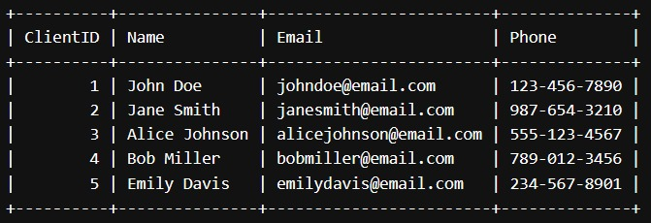
Clients Table:
OUTPUT SCRENSHOTS

Slide 8

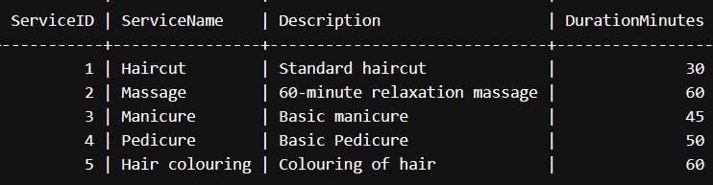

Services Table

Slide 9

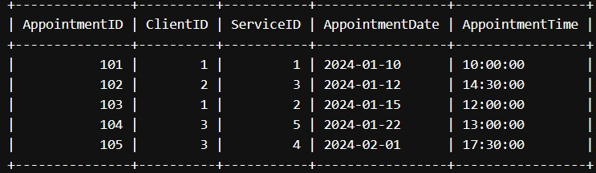
Appointments Table

Slide 10
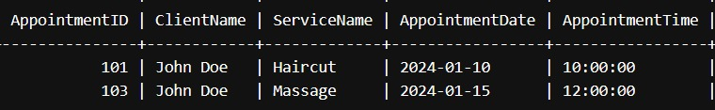
Querying appointments for a specific client
SELECT
Appointments.AppointmentID, Clients.Name AS ClientName, Services.ServiceName, Appointments.AppointmentDate, Appointments.AppointmentTime
FROM
Appointments
JOIN
Clients ON Appointments.ClientID = Clients.ClientID
JOIN
Services ON Appointments.ServiceID = Services.ServiceID
WHERE
Clients.ClientID = 1;

Slide 11
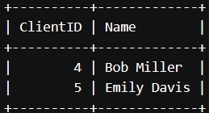
Clients Without Appointments
Clients.ClientID, Clients.Name FROM Clients
LEFT JOIN Appointments ON Clients.ClientID = Appointments.ClientID
WHERE Appointments.AppointmentID IS NULL;

Slide 12
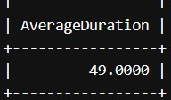
Average Service Duration
SELECT AVG(DurationMinutes) AS AverageDuration FROM Services;

Slide 13
FUTURE SCOPE
This proposed system is very useful and easy to implement anywhere.This provides easy access to past data and is also easy to implement new data.
We can add more tables,more rows in each table and also ask various types of new queries in the future.

Slide 14
Thank You!
22911A0555
SHAIK MOHAMMED ABDUS SAMEE

